Slide 1
Credit Card Fraud Analytics
By
Shirali Shah
shirali.shah.1982@gmail.com
LinkedIn: https://www.linkedin.com/in/sshah1982
GitHub: https://github.com/sshah1982
Link: https://public.tableau.com/app/profile/shirali.shah2788/viz/Credit_Card_Fraud_Analytics_Dashboard/Dashboard

Slide 2
Problem Description
Fraud is a big problem for banks and financial institutions. Every year, billions of dollars are lost to fraudsters who find ways to exploit weaknesses in the system.
There are several types of bank frauds like credit card fraud, phishing, mortgage fraud, credential stuffing, fraudulent documents etc.

Slide 3
Problem Description (Contd.)
There are several types of credit card fraud, including skimming, card-present fraud, application fraud, and account takeover.
Skimming: A thief uses a device to capture your credit card information while you're making a transaction, such as at an ATM.
Card-present fraud: A thief shows a duplicate credit card to an agent in person.

Slide 4
Problem Description (Contd.)
Application fraud: A thief steals your identity to open a credit card account in your name.
Account takeover: A thief gains control of your account and makes unauthorized transactions.

Slide 5
Problem Description (Contd.)
Credit card fraud can happen online (via e-mail or text) or in person. The main aim of scammers is to purchase goods or services with stolen cards or copied details. Apart from this, they can also withdraw money or transfer cash. These cybercriminals and scammers have plenty of ways to deceive cardholders.

Slide 6
Problem Description (Contd.)
By analyzing customer data, IP addresses, and transaction patterns, fraud prevention solutions can flag unusual activities and provide a risk score. This continuous monitoring ensures that businesses can immediately respond to potential threats, safeguarding both the company and its customers from financial harm.

Slide 7
Problem Description (Contd.)
In order to detect and analyze credit card fraud, we need at least five key data points that can serve as red flags. They include the cardholder's transaction history and personal information, merchant information, location data, as well as device information.

Slide 8
About dataset
The dataset has been taken from Kaggle (https://www.kaggle.com) which is a web based platform and online community for data scientists and machine learning practitioners. It provides public data sets for training and testing.
It contains credit card transactions for all states of US for year 2019.
It has 10,00,000+ rows and 23 fields from which 22 are input variables and 1 is output variable.

Slide 9
About dataset (Contd.)
It contains information like Transaction Date and Time, Credit Card Number, Merchant Name, Merchant Information like Latitude and Longitude, Transaction Category, Fraud Amount, Customer Personal Information(Name, Gender, Address, DOB, Job), City Population, City Latitude and Longitude etc.

Slide 10
About dataset (Contd.)
Data type | Total | Purpose
String | 9 | Nominal data
String (Binary) | 1 | Used for binary classification e.g. Gender (M/F)
Numeric (Whole) | 5 | Whole numbers without decimal point
Numeric (Decimal) | 5 | Decimal numbers e.g. Transaction amount
Date | 1 | Dates e.g. Date of Birth
Date & Time | 1 | Dates with time component e.g. Transaction Date & Time
Total Input Variables | 22

Slide 11
About dataset (Contd.)
It is also worth noting variable classifications to better understand the dataset. Note that not all variables would contribute to the creation of final dashboard.
Classification of variables | Total
Nominal | 11
Ordinal | 2
Interval | 7
Ratio | 2
Total Input Variables | 22

Slide 12
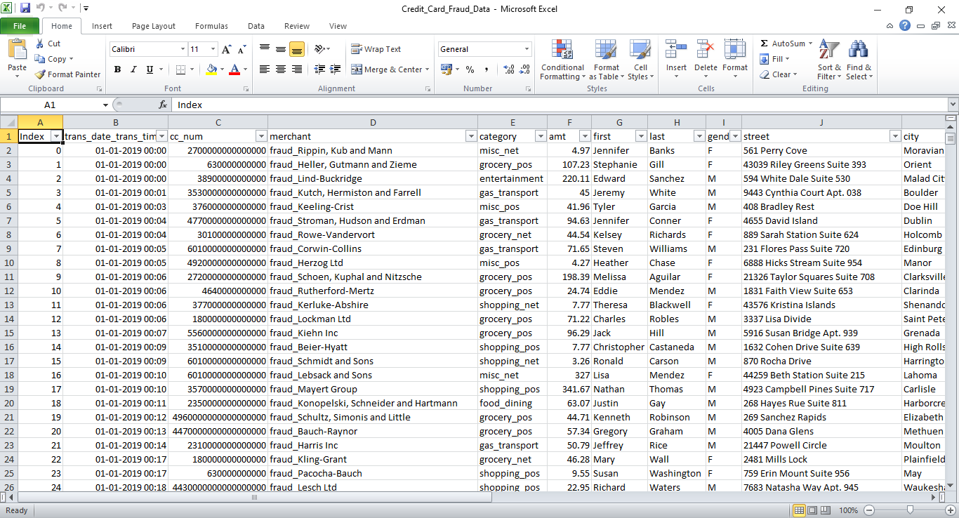
Actual Dataset

Slide 13
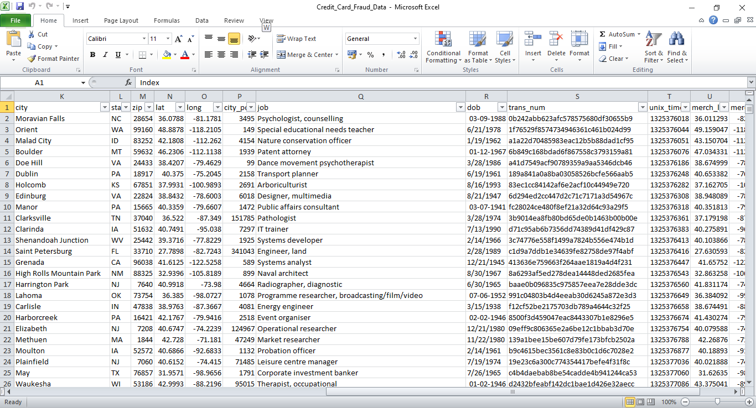
Actual Dataset (Contd.)

Slide 14
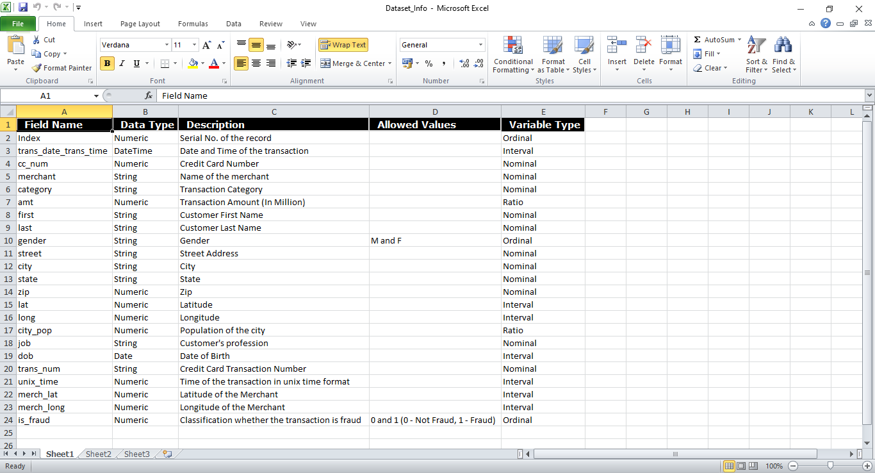
Dataset Information

Slide 15
Starting the Analysis
To start with the analysis of credit card fraud detection, it is necessary to follow the 5 factors of data analysis. Those are:
1. Identify the users or stakeholders for the dashboard.
2. Identify metrics or KPIs that matter the most.
3. Understand the objectives and goals of the user.
4. Data cleaning activities
5. Ask business questions

Slide 16

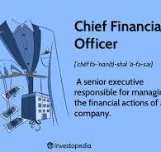
Step 1: Identify the users or stakeholders for the dashboard.
User Persona : Chief Finance Officer

Slide 17
User Persona : Chief Finance Officer
Responsibilities:
Ensure the overall financial integrity of the organization & safeguard financial assets against fraud activities.
Make informed and strategic decisions based on accurate financial information.
Evaluate risks and opportunities to support the organization's financial goals.
Implement policies and procedures to mitigate legal and financial risks.
Optimize resource allocation to maximize financial efficiency.
Allocate budgets strategically to support business objectives.

Slide 18
User Persona : Chief Finance Officer
Needs:
Access to real-time and accurate financial data for effective decision-making.
Intuitive and user-friendly dashboards and tools for efficient monitoring and analysis.
Advanced fraud detection systems that provide proactive alerts and mitigation strategies.
Insights into emerging financial trends, risks, and opportunities to support strategic planning.

Slide 19
User Persona : Chief Finance Officer
Challenges:
Constantly evolving fraud tactics and increasing sophistication of cyber threats.
Minimizing false positives in fraud detection to avoid unnecessary disruption to legitimate transactions.
Managing financial security within budgetary constraints and ensuring cost-effectiveness.

Slide 20
Step 2: Identify the Key Performance Indicators (KPIs)
Numbers tell a story. To gauge the effectiveness of a system, focus on metrics and Key Performance Indicators (KPIs) that truly matter. For fraud detection and prevention, consider these metrics:

Slide 21
Step 2: Identify the Key Performance Indicators (KPIs)
KPI/Measure | Drill down dimensions | Purpose
Fraud Loss Value | Transaction type, Geographical location, Time period, Monetary value | Measure monetary impact, quantify financial losses due to fraud.
Number of Total Incidents | Transaction Type, Geographical location | Quantify frequency of fraudulent incidents, assess scale of the problem.
Fraud Transaction Rate | Type of transactions | Calculate percentage of fraudulent transactions, identify trends.
Geospatial Distribution | Payer location (city, state), Payee location (city, state) | Analyze geographical spread of fraud, target high-risk areas.
User Behaviour | Payer Time of day | Monitor patterns in user behavior, detect anomalies for improved security.

Slide 22
Step 3: Understand the goals & objectives of user
Now, on the basis of KPIs, we need to define our goals and objectives of the users. So that it will align with the data story functionalities to ensure decision making.
Here are the key objectives & goals:

Slide 23
Step 3: Understand the goals & objectives of user
Objective :
‍To enhance the security of financial transactions by employing advanced data analysis techniques. This includes real-time monitoring, anomaly detection, and proactive measures to identify, investigate, and mitigate potential instances of credit card fraud, thereby safeguarding the financial system's integrity.

Slide 24
Step 3: Understand the goals & objectives of user
Goal:
‍To optimize resource utilization for enhanced operational efficiency and profitability, support strategic initiatives by planning finance and investment decisions, minimize financial, fraud, and operational risks to safeguard assets and reputation.

Slide 25
Step 4: Data cleaning activities
This dataset is not indicative of real world as it does not have missing values, wrong data types, unrealistic dates or outliers.
Some basic data cleaning is still required which can drop unrequired fields and create new calculated fields. No sampling is done on the dataset.
The tools used are Tableau Prep Builder (For Data cleaning) and Tableau Desktop (For dashboard creation) 2024 version.

Slide 26
Step 4: Data cleaning activities
Dropped fields:
Index
DOB
Street
Latitude
Longitude
Transaction Number
Merchant Latitude
Merchant Longitude
Unix Time
Is_Fraud Flag

Slide 27
Step 4: Data cleaning activities
New calculated fields:
Transaction Month
Transaction Hour (Intermediate field for calculating Transaction Time of Day)
Transaction Time of Day (Morning, Afternoon, Evening, Night)

Slide 28
Step 5 : Ask business questions
Beyond KPIs, organizations must engage in business-driven inquiry. This involves asking strategic questions that directly align with overarching business objectives.
Ask the following questions:

Slide 29
Business questions
Are there certain regions more prone to fraud incidents than others?
How have total incidents fluctuated over the months? Are there any patterns?
Which categories of credit card transactions are causing the most financial damage?
How does user behavior vary by time of day in terms of number of total transactions? Patterns?
Is there any correlation between state population and no. of total transactions?

Slide 30
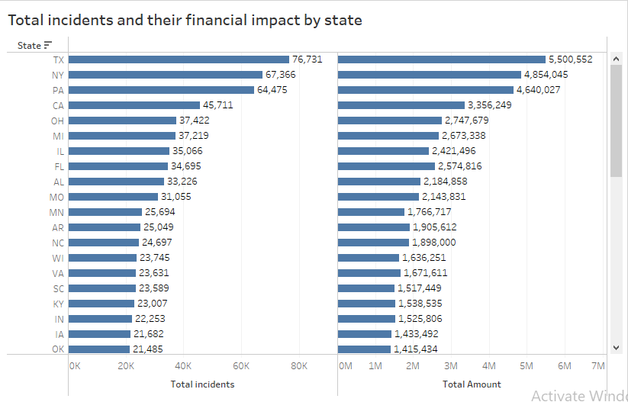
1. Are there certain regions more prone to fraud incidents than others? (Double Bar Chart)

Slide 31
1. Are there certain regions more prone to fraud incidents than others?
Metrics: Total no. of transactions, total amount, payer state
Actionable insights :
States with higher total transaction amounts like TX (Texas), NY (New York), and PA (Pennsylvania) have higher chances of fraud and may benefit from state-specific fraud prevention initiatives.
TX (Texas), showing the highest no. of transactions, should be subjected to more rigorous monitoring and investigative activities.

Slide 32
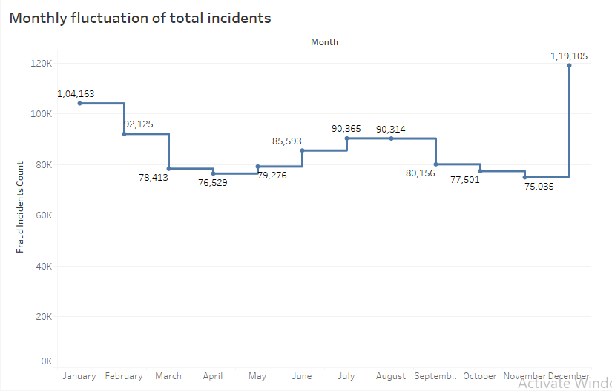
2. How have total incidents fluctuated over the months in year 2019? Are there any trends or patterns? (Line Chart)

Slide 33
2. How have total incidents fluctuated over the months in year 2019? Are there any trends or patterns?
Metrics : Time Period (Month), No. of total transactions
Actionable insights :
The graph shows a clear pattern of highest incidents in December and January. Some of these transactions have a high probability of being fraudulent. This suggests the need for increased vigilance and preventive measures during these months.

Slide 34
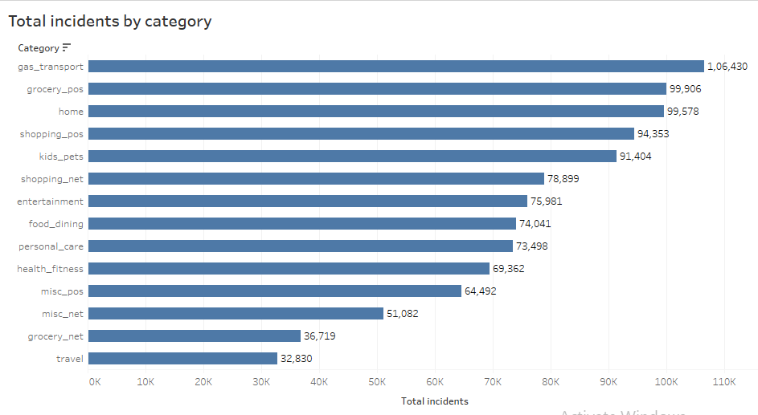
3. Which categories of credit card transactions are causing the most financial damage? (Bar Chart)

Slide 35
3. Which categories of credit card transactions are causing the most financial damage?
Metrics : Transaction category, total no. of transactions
Actionable insights:
Gas Transport and Grocery POS (Point of sale) categories represent the highest total, indicating these areas are particularly high-risk.
Given the high amount of fraud in credit cards, there could be an opportunity to educate customers on safe credit card practices.

Slide 36
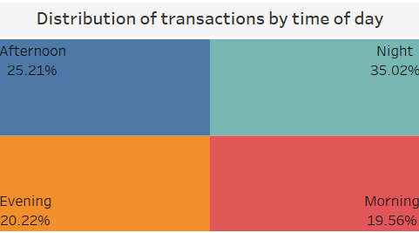
4. How does user behavior vary by time of day in terms of number of total transactions? (Pie Chart)

Slide 37
4. How does user behavior vary by time of day in terms of number of total transactions?
Metrics : Time of Day, Total no. of transactions
Actionable Insights :
The largest share of transactions occurs at night (35.02%). Some of them have high probabilities of being fraudulent.
This is suggesting that fraudsters may prefer time when oversight may be lower and victims are less vigilant.

Slide 38
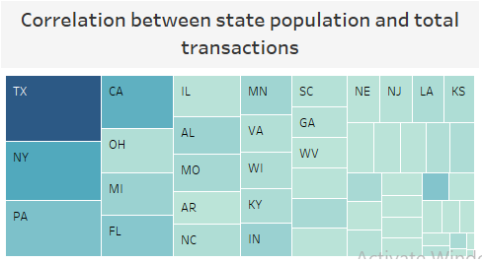
5. Is there any correlation between state population and no. of total transactions? (Tree Map – Correlation Matrix)

Slide 39
5. Is there any correlation between state population and no. of total transactions?
Metrics : Total no. of transactions, state population, payer state
Actionable Insights :
There is a direct correlation between state population and no. of transactions.
TX (Texas), NY (New York), and PA (Pennsylvania) are the top states for total no. of transactions and some of them have high probabilities of being fraudulent indicating the need for targeted anti-fraud initiatives in these states.

Slide 40
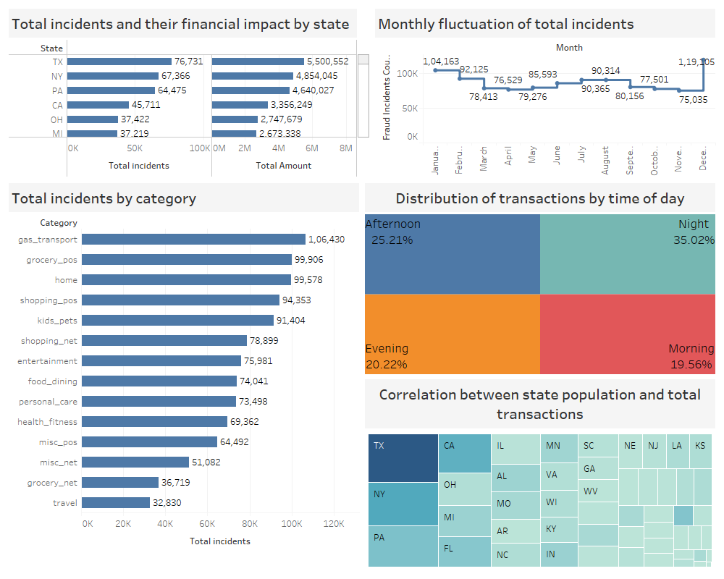
Entire Dashboard

Slide 41
Questions which can be answered
By analyzing the data, trends and patterns in the dashboard, few insights can be derived:
TX (Texas), NY (New York), and PA (Pennsylvania) states have highest total transactions. Some of these transactions have high probabilities of being fraudulent particularly the ones which occur at night. So these states require thorough anti-fraud initiatives.
Gas Transport and Grocery POS transactions have high chances of being fraudulent so these activities require thorough vigilance.

Slide 42
Questions which cannot be answered
Overall, this dashboard shows which transactions have high probabilities of being fraudulent.
Exact tagging can be done only using AI (Artificial Intelligence) and ML (Machine Learning) algorithms along with some manual intervention from state authorities.

Slide 43
Further Scope
The original dataset for this dashboard contains some geo spatial fields like Latitude, Longitude as well as merchant Latitude and Longitude.
They can be utilized for analysis to derive insights like:
Which merchants have highest probability of being fraud
Which streets/areas of a city have highest probability of fraud incidents

Slide 44
Further Scope (Al and ML integration)
Credit card fraud detection relies heavily PCA (Principal Component Analysis), Linear Regression, Logistic Regression and Decision Trees.
The further process:
A credit card fraud detection model would be trained on historical transaction data to identify patterns indicative of fraudulent activity.

Slide 45
Further Scope (Al and ML integration – Contd.)
=> By performing feature engineering (Dimensionality Reduction) through methods like Principal Component Analysis (PCA), we can transform a large number of variables into a smaller set of uncorrelated components while retaining important information.
By using Logistic Regression (Classification) on the data from previous step, transactions can be tagged as Legitimate or Fraudulent. By combing this technique with Decision Trees, accuracy of the model can be improved further.

Slide 46
Further Scope (Al and ML integration – Contd.)
=> Going one step ahead, Linear Regression can be used as a Predictive Analysis technique to forecast whether particular customers or merchants are highly probable of committing frauds in future.

Slide 47
Any questions?
Thank You
I can be reached at:
shirali.shah.1982@gmail.com
LinkedIn: https://www.linkedin.com/in/sshah1982
GitHub: https://github.com/sshah1982
Link: https://public.tableau.com/app/profile/shirali.shah2788/viz/Credit_Card_Fraud_Analytics_Dashboard/Dashboard

